Slide 1
Q1 2014 CAR Analysis
Team:
Alan Purvey
Julie Heinzinger
Mark Jessen
CAR Number: 133912654
CAR Number: 133911539
CAR Number: 133912730
CAR Number: 133912451

Slide 2
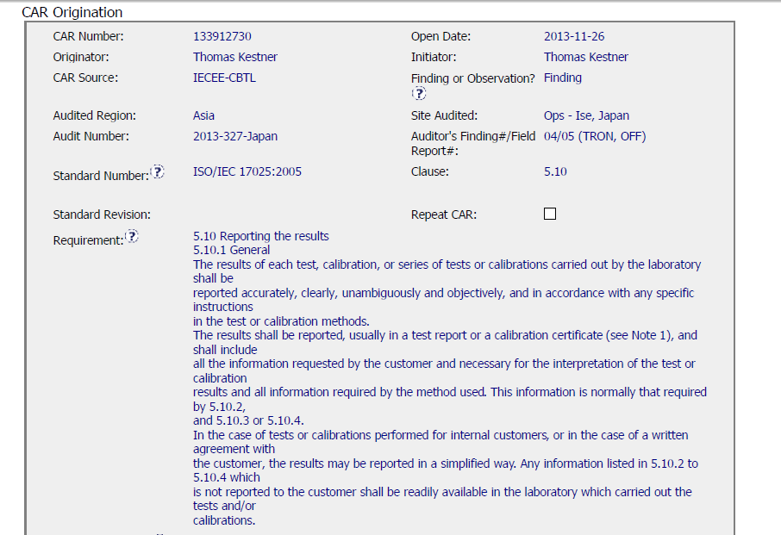
Finding CAR 133912730
Entered into GCAR timely - 4 days after the closing meeting.

Slide 3
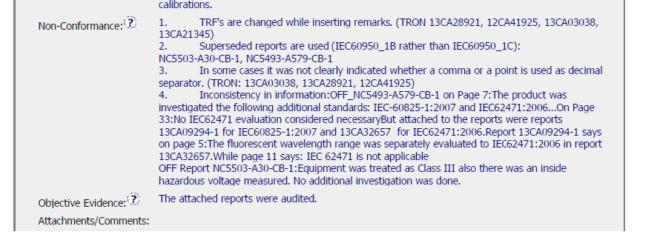
Finding CAR 133912730
not on attached table but referenced
13CA09294
13CA32657
Not clear how many were evaluated?
Usually the Non-conformance is x of x
This was an accreditor CAR and they are not always written as we would write them

Slide 4
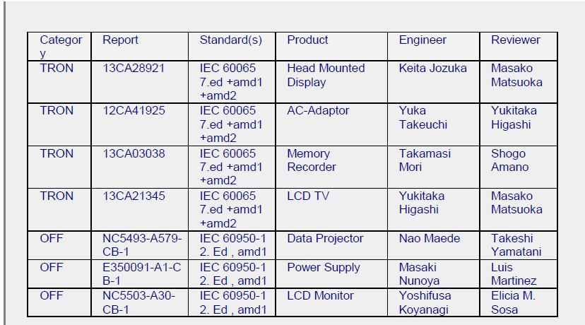
Finding CAR 133912730
Table attached in the comment / attachments section
Projects referenced in non-conformance but not on table
13CA09294
13CA32657

Slide 5
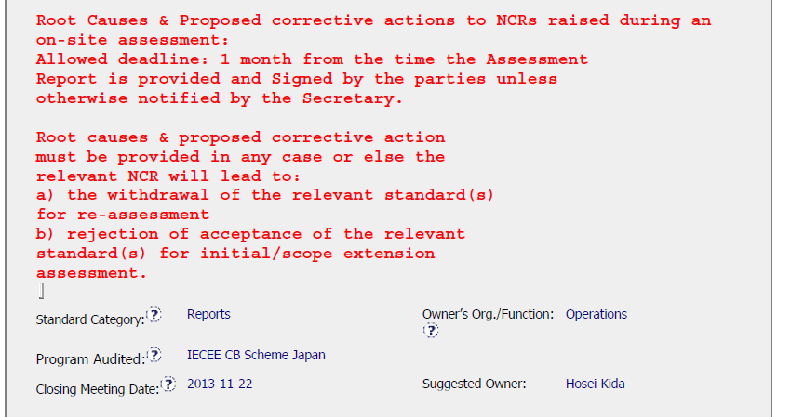
Finding CAR 133912730
Unclear when the root cause and proposed corrective action are due because we do not know when the assessment report is issued. Might be at the closing meeting, might be later.

Slide 6
Finding CAR 133912730 – Analysis Summary
It was confusing and hard to follow
Process used to evaluate was not explained in the analysis
It might have been best to break this up into manageable parts, especially if different people are responsible.
Explanation is missing
Without having some CB background anyone reading this will be extra confused since none of this is explained in the analysis.
Based on the ppt included in Milestone 1, it looks like more might have been done than what is in the analysis, however unless it is clearly documented in the analysis, how would anyone know?

Slide 7
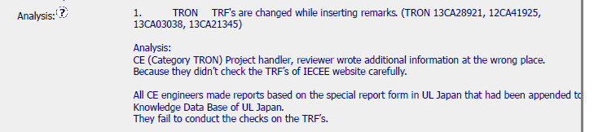
Finding CAR 133912730 - Analysis
Analysis incomplete
Who was consulted / involved in this analysis
Were the jobs in question examined during the analysis, and if so what did they indicate?
Is the issue the report form used or the changes being made?
NOT CLEAR IF THE ISSUE IS:
USE OF AN UNCONTROLLED FORM,
A FORM IS BEING CHANGED,
A COMBINATION OF THE TWO.
Who was consulted is not included, might be the project handler and reviewer, or it could be that the person conducting the analysis just guessed because of the nature of non-conformance.
Unclear if the projects in question were looked at during the analysis.
Unclear if the cause is that UL Japan has saved the TRF’s locally when the requirement is to take the forms from the IECEE website. Or if it has something to do with adding information to the form.
Not sure what “wrote additional information at the wrong place” means.

Slide 8
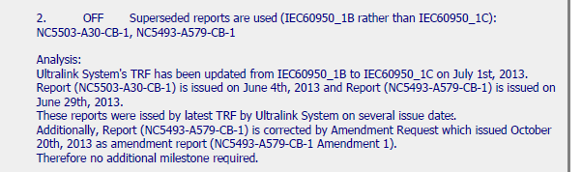

Finding CAR 133912730 - Analysis
Analysis incomplete
Who was consulted / involved in this analysis
Did not reference the UltraLink CAR 133912085 in the analysis, but it is included in the CAR Reference section
Did not address the Ultralink issue at all, just said it was fixed
Looks like one of the projects referenced was corrected [NC5493…]
The other project was not mentioned
Questions left unanswered:
Why were the old ones in Ultralink?
Why was it not updated at the time it reeved to C?
Could reference CAR here
How long has this been happening? When did rev C change?
Did someone give authorization to use the old ones?
Is whatever happed to Ultralink fixed so this will not happen again?
Not sure why no additional milestone is needed, and do they mean action rather than milestone? Either was incorrect.

Slide 9
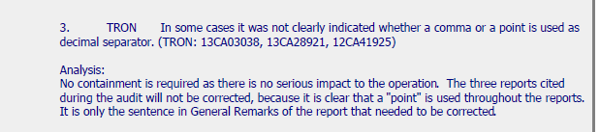
Finding CAR 133912730 - Analysis
Analysis incomplete
Who was consulted / involved in this analysis
Need more information, as to who looked at the projects to decide they were okay
Was it someone of authority (like L4) to determine there was no serious impact
Is there anything else that needs to be considered (like why did IECEE have an issue with this)
Indicated a sentence needs correction, but then nothing is changed.

Slide 10
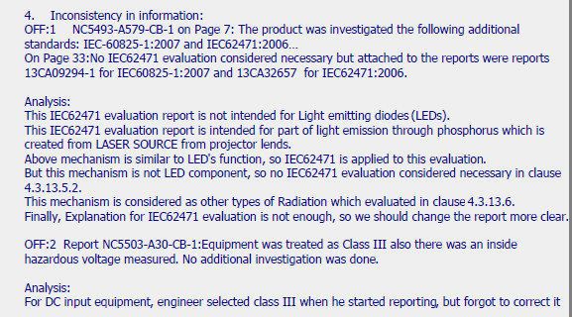
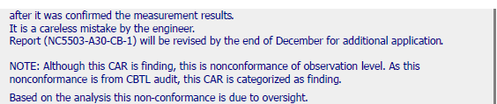
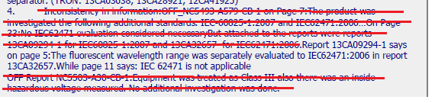
Finding CAR 133912730 - Analysis
Analysis incomplete
Who was consulted / involved in this analysis
No explanation and not how it is applicable to the analysis.
OFF 1 –
Without an explanation, not sure why LED’s matter, why radiation matters, etc.
Include title of IEC62471
Needs an explanation, especially when dealing with technical issues. Need to summarize so others can understand.
OFF 2 –
Without an explanation, not clear the difference between class III and ?
(guess, class II)
What needed to be changed?
NC indicated an investigation was need “ . . No additional investigation was done.” Should one be done or did the “careless mistake” cause the issue?
Why would this be an OBS? Is this necessary to include?
How can this statement pertain to the entire CAR?
Missed sentence from non-conformance. Thus, this issue was not addressed.

Slide 11

Finding CAR 133912730 – Root Cause and Scope
Root Cause:
Not appropriate,
All issues need to be addressed
Analysis was not done well, so it is unclear what the root causes are
Scope:
There was nothing in the analysis which indicated the scope of the issue. How do they know it is limited as indicated.

Slide 12
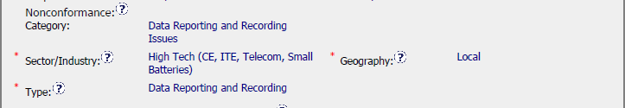
Finding CAR 133912730 – Scope
Without a complete analysis, it is not possible to determine the geography or the nonconformance category.

Slide 13
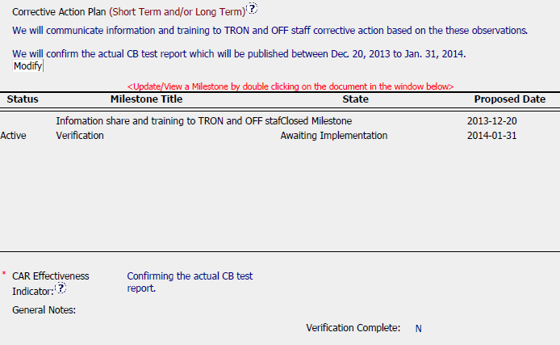
Finding CAR 133912730 – Corrective Action
Without a clear analysis, it is not possible to put together a relevant CAP.
If this were relevant, there is nothing indicating why these things would be done.
No containment or statement indicating why it is not needed (sort of tried to do this in parts of the analysis)
Not clear what the confirmation is about?

Slide 14
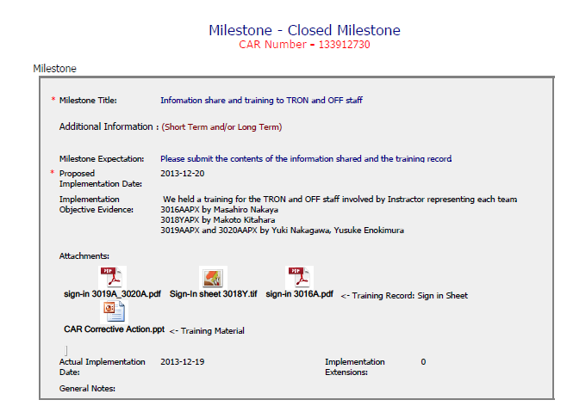
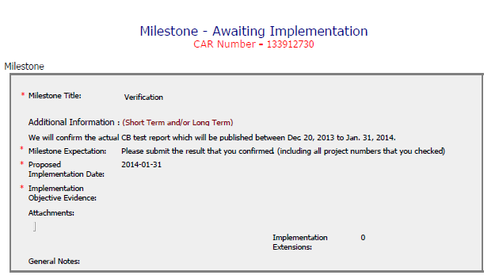
Finding CAR 133912730 – Milestones
At this point, not realistic to discuss milestones because they are based off a flawed analysis.

Slide 15
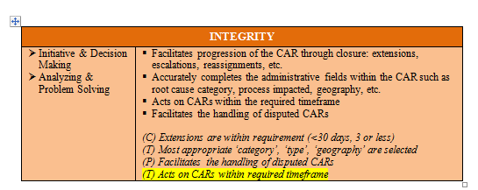
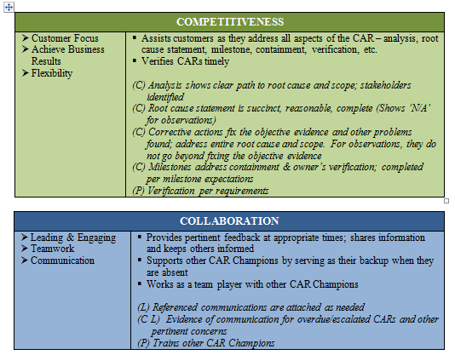
Finding CAR 133912730
Only 1 of the CBS criteria was demonstrated.

Slide 16
Corrective Action Review for Calibration Meeting (March, 2014)
V 1.0

Slide 17
CAR 133912730
SUMMARY:
Good:
The champion assigned the correct Type, Category and Geography in the CAR database. The champion replied the CAR owner promptly. The owner acted on the CAR within the time frame. There was no extension required by the CAR owner.

Slide 18
CAR 133912730
SUMMARY:
Improvement Opportunities Identified:
Analysis: It is better to identify who was involved during the analysis.
Root Cause Statement: Root cause statement should match the analysis, especially for item 1.
Scope of Nonconformance: The CAR was deemed as Observation by the CAR owner. It is better that the CAR owner provides the evidence to support scope of nonconformance was limited to the projects cited, then the champion provides the comments and confirmation about this classification change and scope reduction.
Corrective Action plan: It is better that there are long term corrective actions to address all issues identified in the CAR from the root cause.
Milestone: According to 00-QA-S0006, V19.0, Containment milestone is required for the Corrective action to address Finding.

Slide 19
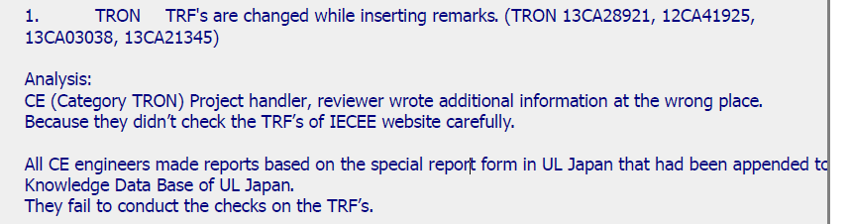
CAR 133912730
Analysis: It is better to identify who was involved during the analysis.

Slide 20
CAR 133912730
Root Cause Statement: Root cause statement should match the analysis, especially for item 1. Since all CE engineers did not use the TRF from IECEE CB website or Ultralink, it seems the issue was systematic instead of “ oversight”.

Slide 21
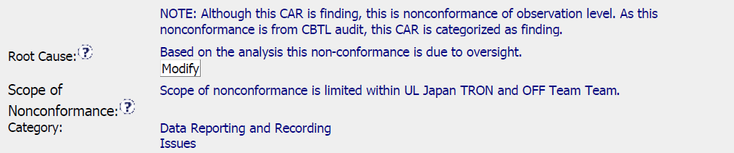
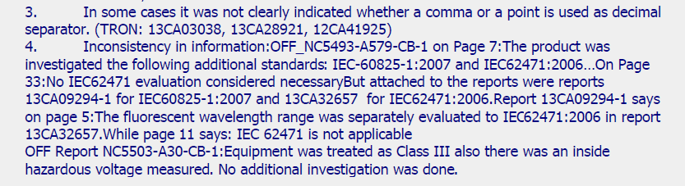
CAR 133912730
Scope of Nonconformance: The CAR was deemed as Observation by the CAR owner. It is better that the CAR owner provides the evidence to support scope of nonconformance was limited to the projects cited, then the champion provides the comments and confirmation about this classification change and scope reduction.
There was no evidence that item 3 and item 4 of nonconformance evidence were limited to the projects identified.

Slide 22
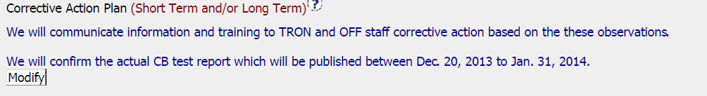
CAR 133912730
Corrective Action plan: It is better that there are long term corrective actions to address all issues identified in the CAR from the root cause.

Slide 23
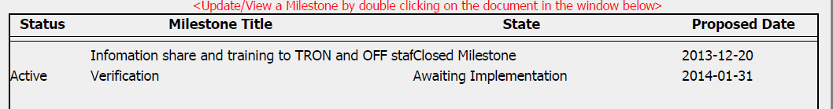
CAR 133912730
Milestone: According to 00-QA-S0006, V19.0, Containment milestone is required for the Corrective action to address Finding.

